Slide 1






Professional Development 101 Summer 2015
© LUMA Institute

Slide 2
Section I: Explore
Discover the world of work

Slide 3
Section I: Explore
Discover the world of work
Section II: Experience
Build your personal toolkit

Slide 4
Section I: Explore
Discover the world of work
Section II: Experience
Build your personal toolkit
Section III: Imagine
Design your future self

Slide 5
Section I: Explore
Introduction
Mapping Relational Networks
Section II: Experience
Attribute Analysis
Résumé by Design
Both Sides of the Interview
Section III: Imagine
Envisioning the Future

Slide 6
Section I: Explore
Introduction
Mapping Relational Networks
Section II: Experience
Attribute Analysis
Résumé by Design
Both Sides of the Interview
Section III: Imagine
Envisioning the Future

Slide 7

Section I: Introduction | Opening Remarks
All work is about creating value !

Slide 8
Section I: Introduction | Opening Discussion
Circle up with a team
Participant
Facilitator

Slide 9
Section I: Introduction | Opening Discussion
Discuss the following questions…
How can I make something that people need or want?
What problem can I solve?
What creative new idea can I bring to life?
What is broken that needs to be fixed?
How can I make someone’s life better?
How can I make something work better and be more efficient?

Slide 10
Section I: Introduction | Opening Activity
Using the Value Creation template, think of a problem you can address at home. Draw or describe it.

Slide 11
Section I: Introduction | Opening Activity
Next, think about (and capture) what you would change

Slide 12
Section I: Introduction | Opening Activity
Finally, illustrate your proposed solution

Slide 13
Section I: Introduction | Opening Activity
Repeat this process for “school,” “neighborhood”

Slide 14
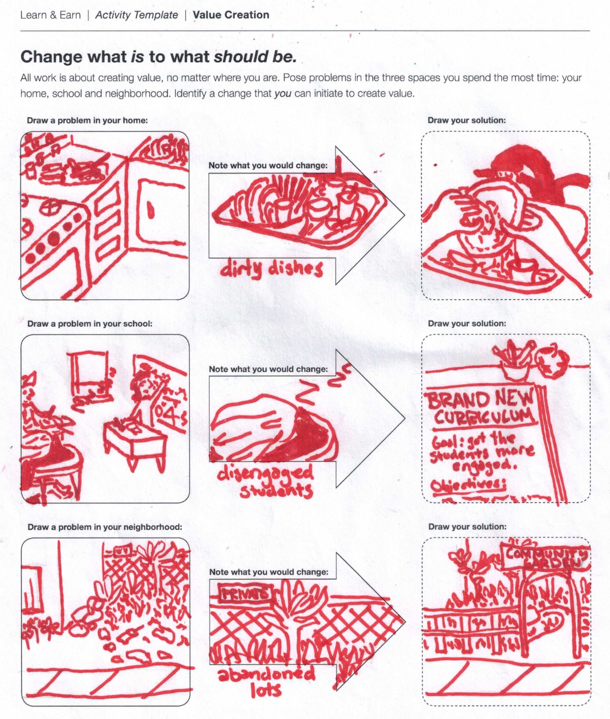
Section I: Introduction | Example
Example:

Slide 15
Section I: Introduction | Opening Activity
“Everyone designs who devises courses of action aimed at changing existing situations into preferred ones.”
HERB SIMON
Nobel Prize Winner in Economics

Slide 16
Section I: Explore
Introduction
Mapping Relational Networks
Section II: Experience
Attribute Analysis
Résumé by Design
Both Sides of the Interview
Section III: Imagine
Envisioning the Future

Slide 17
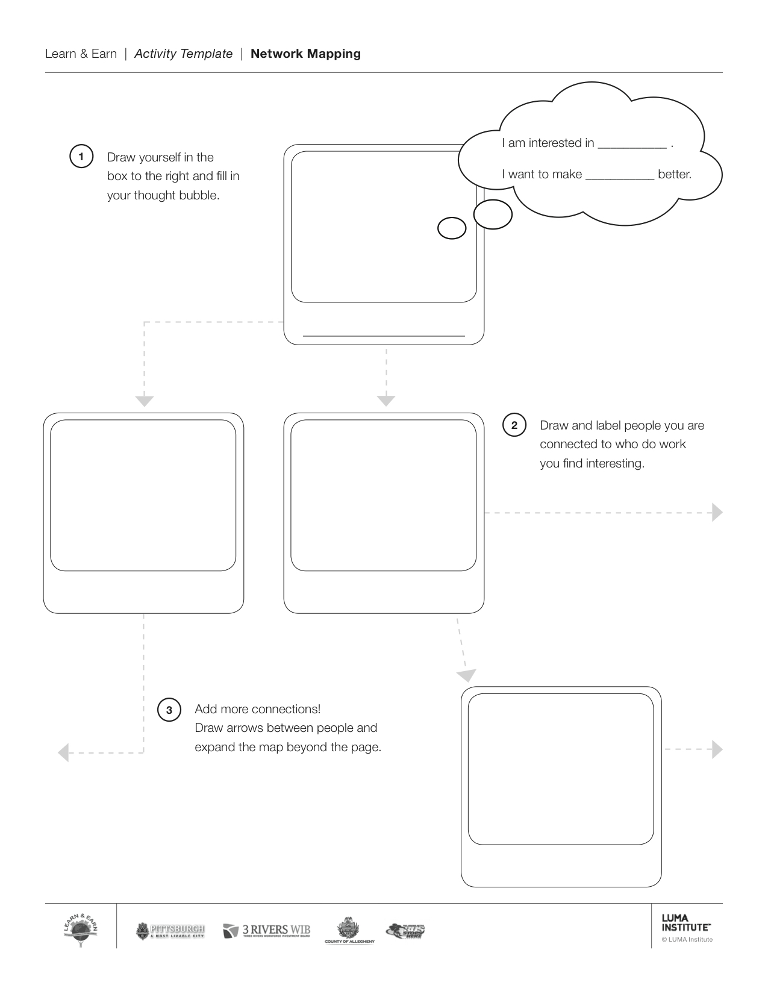
Section I: Mapping Relational Networks | Draw Yourself
Using the Network Mapping template, draw a sketch of yourself, write your name, and fill in the blanks

Slide 18
Section I: Mapping Relational Networks | Map Connections
Next, draw and label people to whom are you connected

Slide 19
Section I: Mapping Relational Networks | Expand the Network
Add more connections! Draw arrows and expand the map beyond the page

Slide 20
Section I: Mapping Relational Networks | Expand the Network
Finally, working in groups, draw connections between your network maps

Slide 21
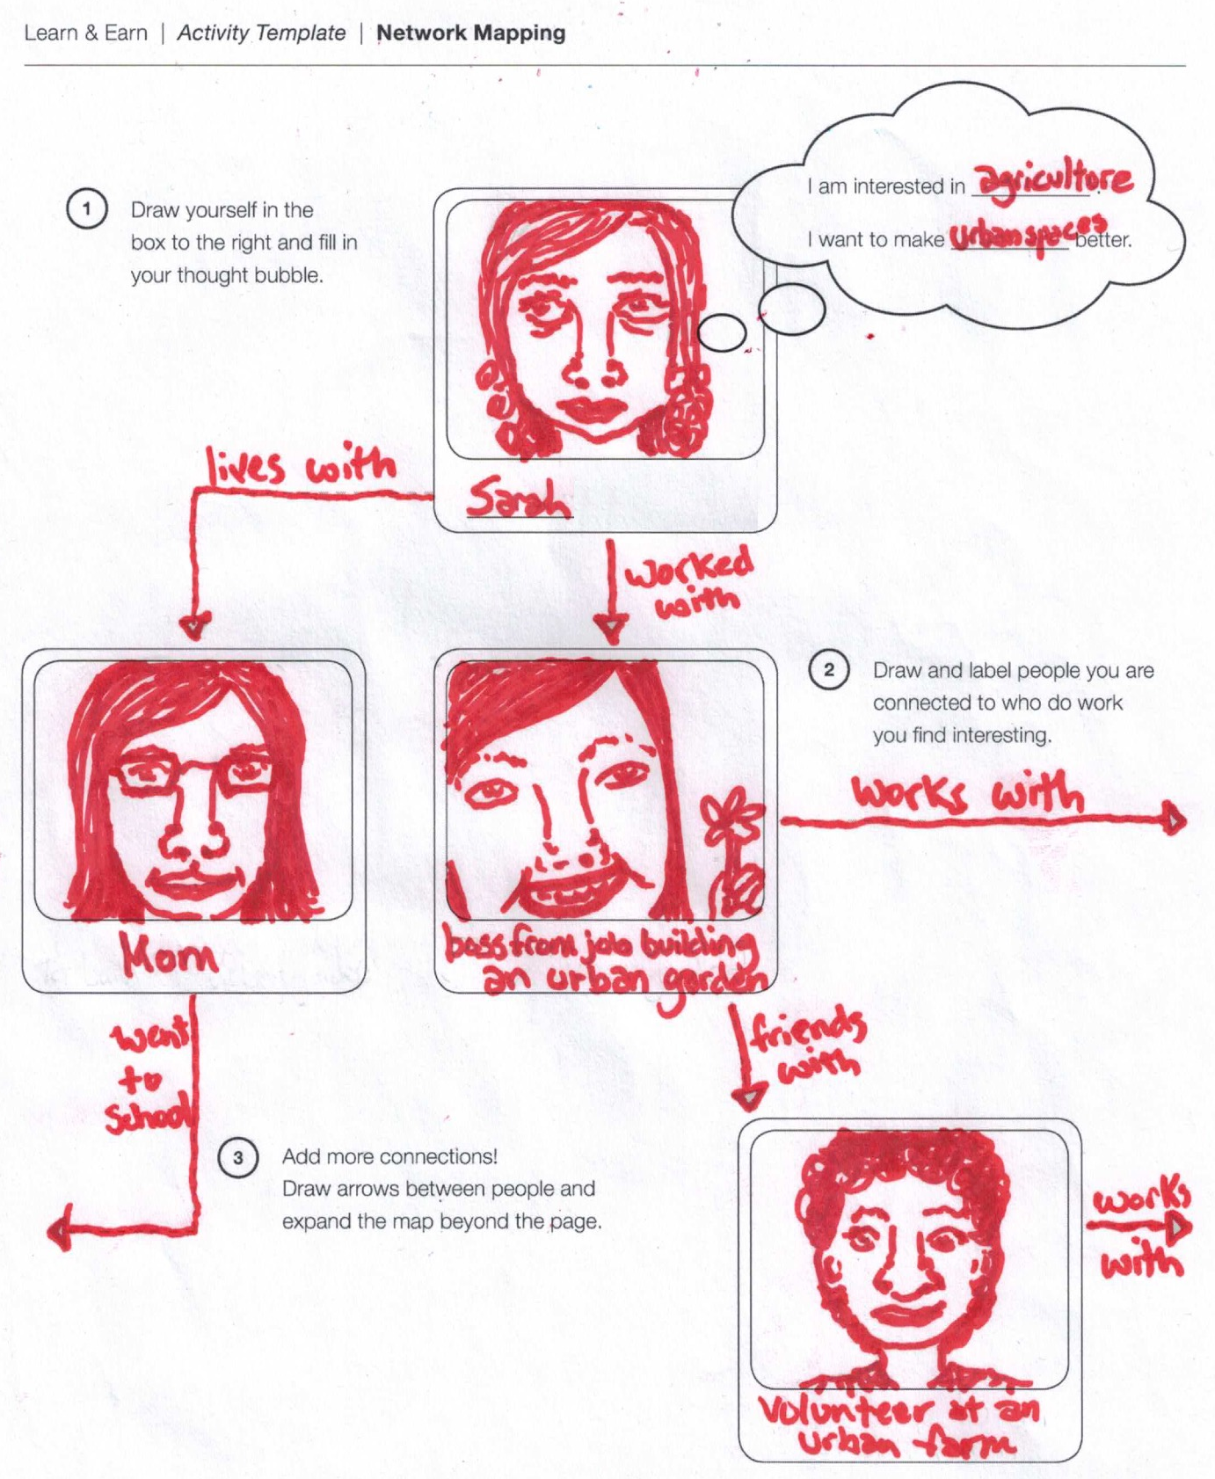
Section I: Mapping Relational Networks | Example
Example:

Slide 22

Section I: Mapping Relational Networks | Tips for Building Your Network
A brief chat on…
Tips for building your network.

Slide 23
Section I: Mapping Relational Networks | Ladder of Production and Marketing
Using the Ladder of Production and Marketing template, choose a product you enjoy or would love to be able to make

Slide 24
Section I: Mapping Relational Networks | Ladder of Production and Marketing
Work your way down the ladder, one rung at a time

Slide 25
Section I: Mapping Relational Networks | Ladder of Production and Marketing
Next, work your way up the ladder

Slide 26
Section I: Mapping Relational Networks | Ladder of Production and Marketing
Identify specific jobs that match up with each rung of the ladder; highlight the rung that most interests you

Slide 27
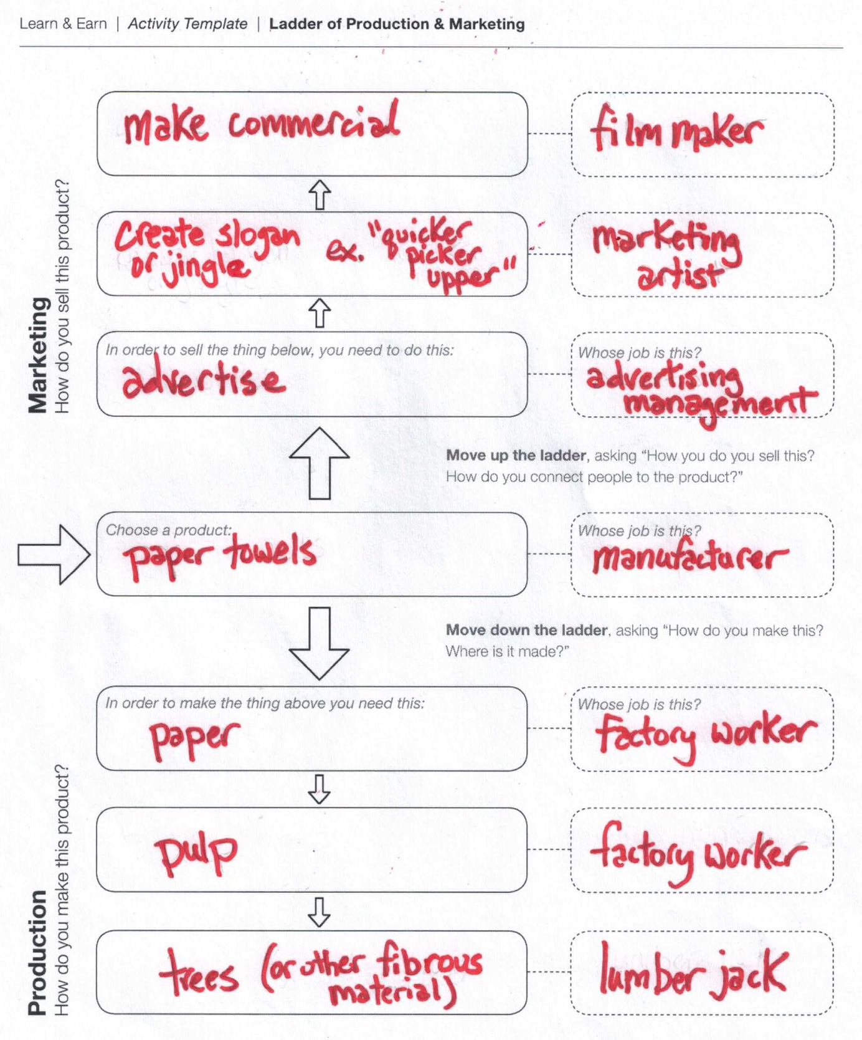
Section I: Mapping Relational Networks | Example
Example:

Slide 28
Section I: Mapping Relational Networks | Tips for Finding Work
A brief chat on…
Tips for finding work.

Slide 29
Section I: Mapping Relational Networks | Closing Remarks
What did you learn about the types of work in the world?
Was anything surprising to you?
How could you add value to your Network Map or Ladder of Production and Marketing?

Slide 30
Section I: Explore
Introduction
Mapping Relational Networks
Section II: Experience
Attribute Analysis
Résumé by Design
Both Sides of the Interview
Section III: Imagine
Envisioning the Future

Slide 31
Section II: Attribute Analysis | Identify the Roses
Using the Attribute Analysis template, identify (and draw) your positive attributes

Slide 32
Section II: Attribute Analysis | Watch the Thorns
Next, identify (and draw) your negative attributes and struggles

Slide 33
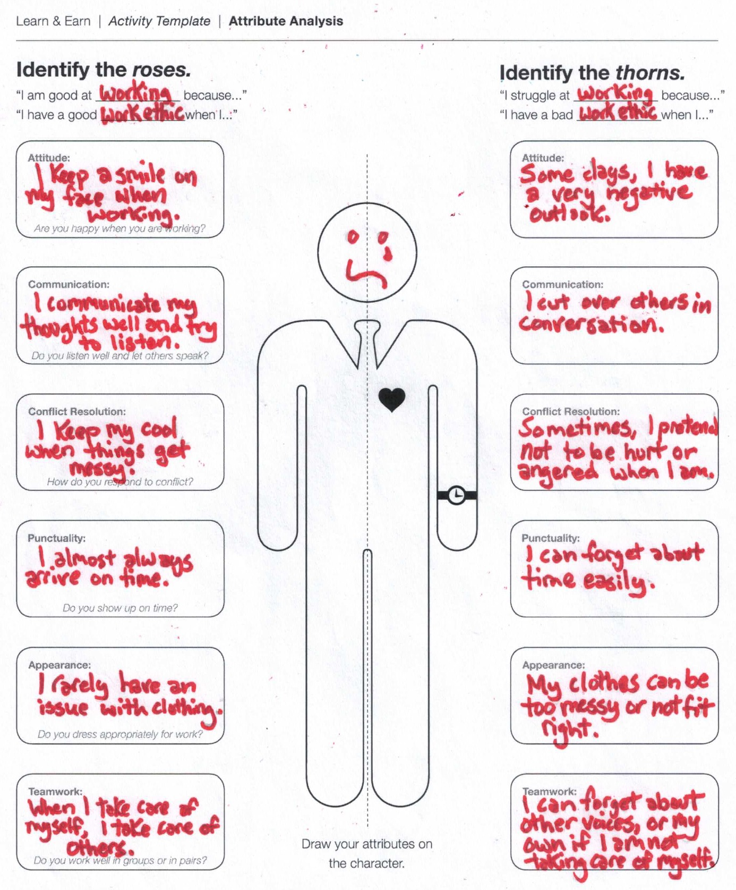
Section II: Attribute Analysis | Example
Example:

Slide 34
Section II: Attribute Analysis | Plan for Growth
Using the Attribute Growth template, identify possible points of improvement and growth for each attribute

Slide 35
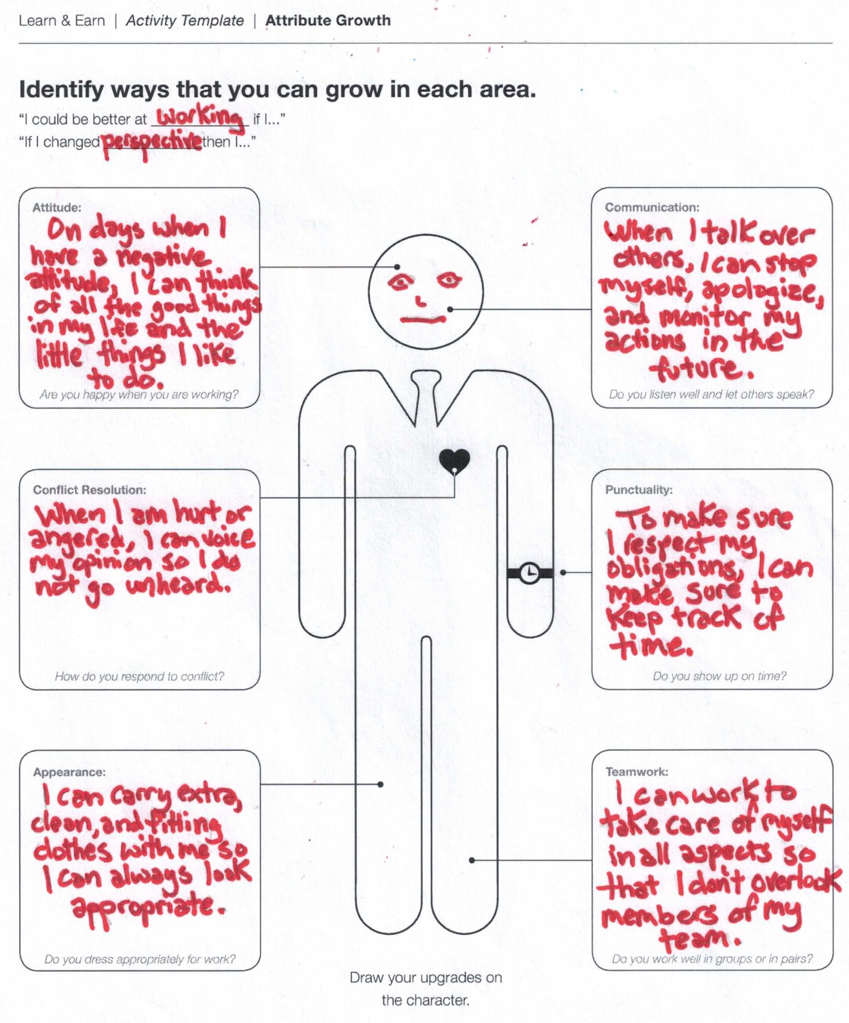
Section II: Attribute Analysis | Example
Example:

Slide 36
Section II: Attribute Analysis | Tips for Personal Improvement
A brief chat on…
Tips for personal improvement.

Slide 37
Section I: Explore
Introduction
Mapping Relational Networks
Section II: Experience
Attribute Analysis
Résumé by Design
Both Sides of the Interview
Section III: Imagine
Envisioning the Future

Slide 38
Section II: Résumé by Design | Consider the Reader
Using the Reader-Centered Résumé template, identify your work goal

Slide 39
Section II: Résumé by Design | Consider the Reader
Why are you writing this résumé? What are its goals? Write down your response in the given box

Slide 40
Section II: Résumé by Design | Consider the Reader
Who is your audience? Who will be affected if you start to work at this company?

Slide 41
Section II: Résumé by Design | Consider the Reader
What is the situation surrounding your application? Do you have an existing relationship with your employer?

Slide 42
Section II: Résumé by Design | Consider the Reader
What kind of skills, education, background are they looking for?

Slide 43
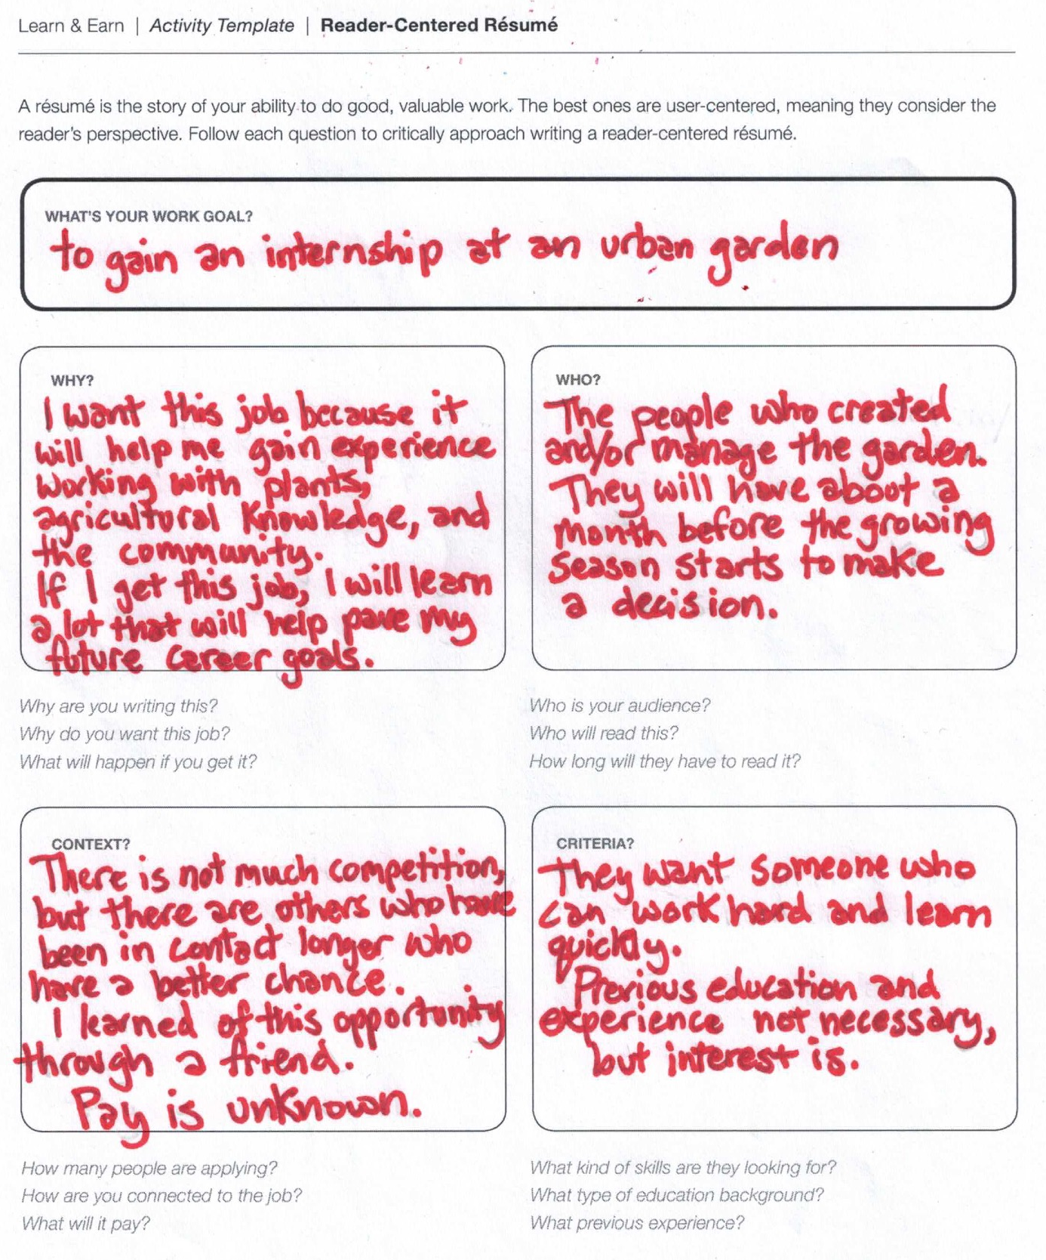
Section II: Résumé by Design | Example
Example:

Slide 44
Section II: Résumé by Design | Create the Content
In the Résumé Designer template, provide some key information about yourself

Slide 45
Section II: Résumé by Design | Create the Content
Next, capture key aspects of your work experience

Slide 46
Section II: Résumé by Design | Create the Content
Write down key skills you have that are relevant to the work you want to do next

Slide 47
Section II: Résumé by Design | Create the Content
Capture learning experiences that have prepared you for the work you want to do

Slide 48
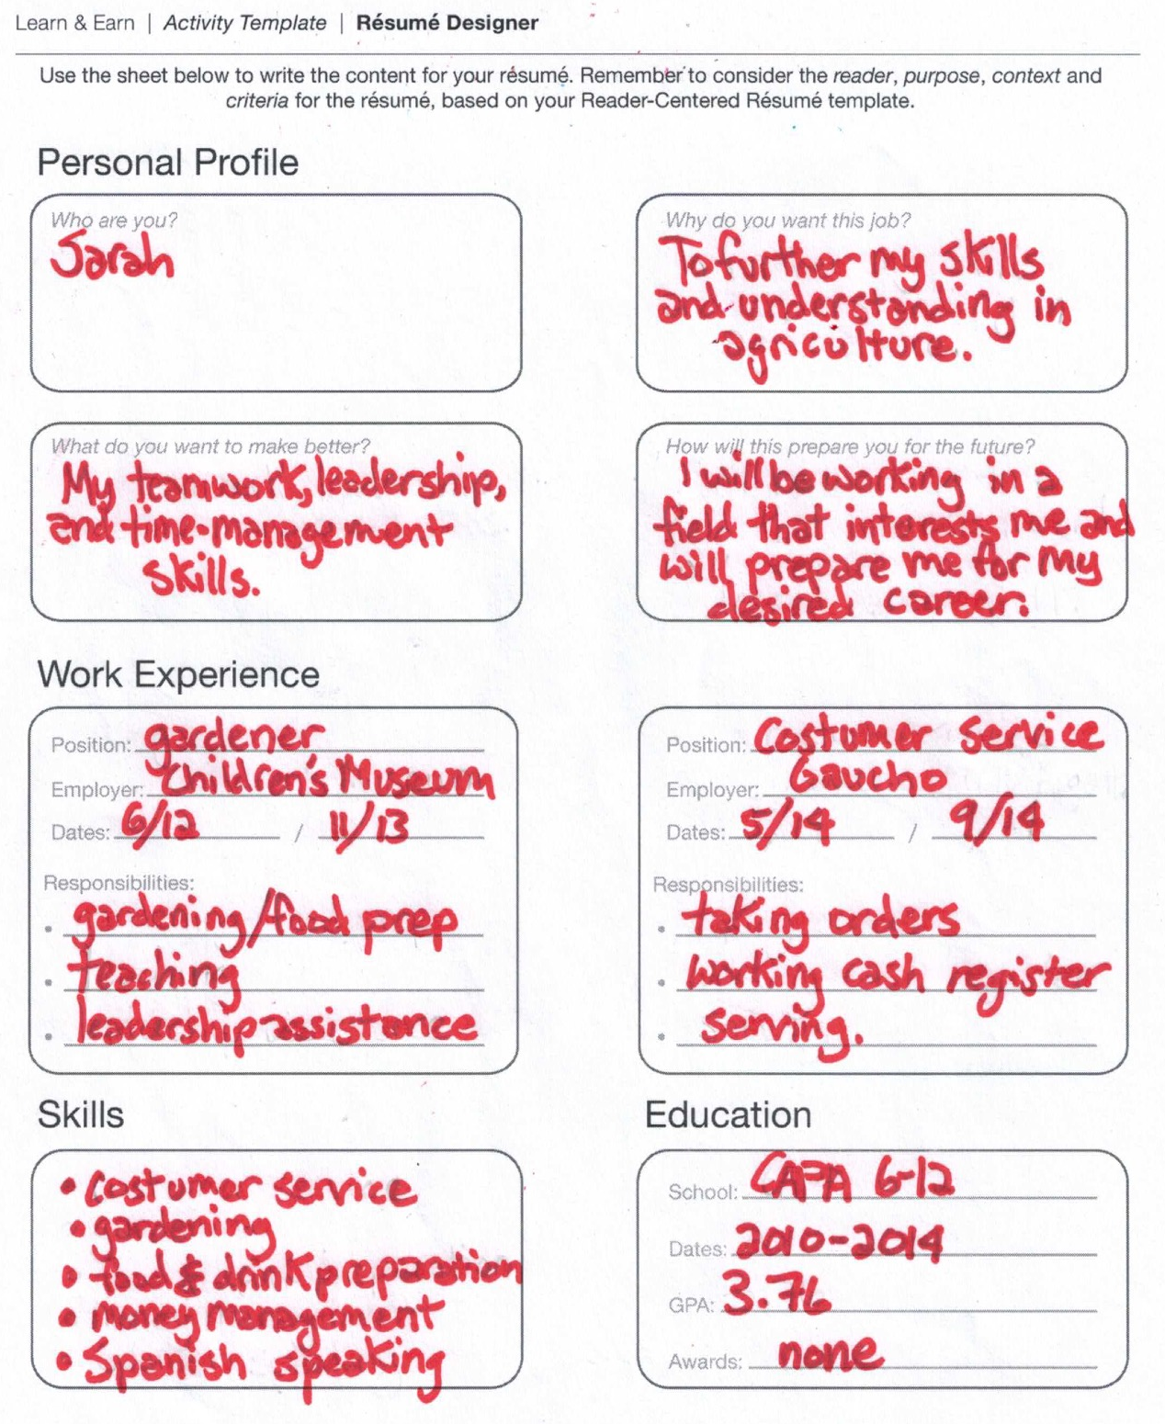
Section II: Résumé by Design | Example
Example:

Slide 49
Section I: Explore
Introduction
Mapping Relational Networks
Section II: Experience
Attribute Analysis
Résumé by Design
Both Sides of the Interview
Section III: Imagine
Envisioning the Future

Slide 50
Section II: Both Sides of the Interview | Get the Interview Materials
First, pair up your group with another group. One group will take on the “Interviewer” role, the other the “Applicant” role
“Interviewer” Group
“Applicant” Group

Slide 51
Section II: Both Sides of the Interview | Prepare for the Interview
“Interviewer” groups: review the Interviewer Persona template, and give your interviewer a name and a face

Slide 52
Section II: Both Sides of the Interview | Prepare for the Interview
Next, fill in an additional question, assign one question per person, and create a “batting order” in which you will ask questions

Slide 53
Section II: Both Sides of the Interview | Prepare for the Interview
“Applicant” groups: review the Applicant Persona template, and give your applicant a name and a face

Slide 54
Section II: Both Sides of the Interview | Prepare for the Interview
Next, develop a strategy for how you will act out the applicant persona, and create a “batting order” in which you will answer questions
4th
3rd
2nd
1st
1st
2nd
3rd
4th
Interviewers
Applicants

Slide 55
Section II: Both Sides of the Interview | Begin the Interview
Conduct your interviews! Once interview complete, each person share out one personal observations.
1st
1st
Interview
“Hot Seat”
~1 min. per question
4th
3rd
2nd
2nd
3rd
4th
Interviewers
Observe & take notes
“Tag in” when your turn
Applicants
Observe & take notes
“Tag in” when your turn

Slide 56
Section II: Both Sides of the Interview | Wrap-Up
What did you learn about yourself today?
Where do you feel the most prepared?
Where do you feel the most unprepared?
If you could add one thing to your résumé, what would it be?

Slide 57
Section I: Explore
Introduction
Mapping Relational Networks
Section II: Experience
Attribute Analysis
Résumé by Design
Both Sides of the Interview
Section III: Imagine
Envisioning the Future

Slide 58
Section III: Envisioning the Future | Storyboarding: Year 2016
Illustrate your career growth one (1) year from now.

Slide 59
Section III: Envisioning the Future | Storyboarding: Year 2020
Illustrate your career growth five (5) years from now.

Slide 60
Section III: Envisioning the Future | Storyboarding: Year 2025
Illustrate your career growth ten (10) years from now.

Slide 61
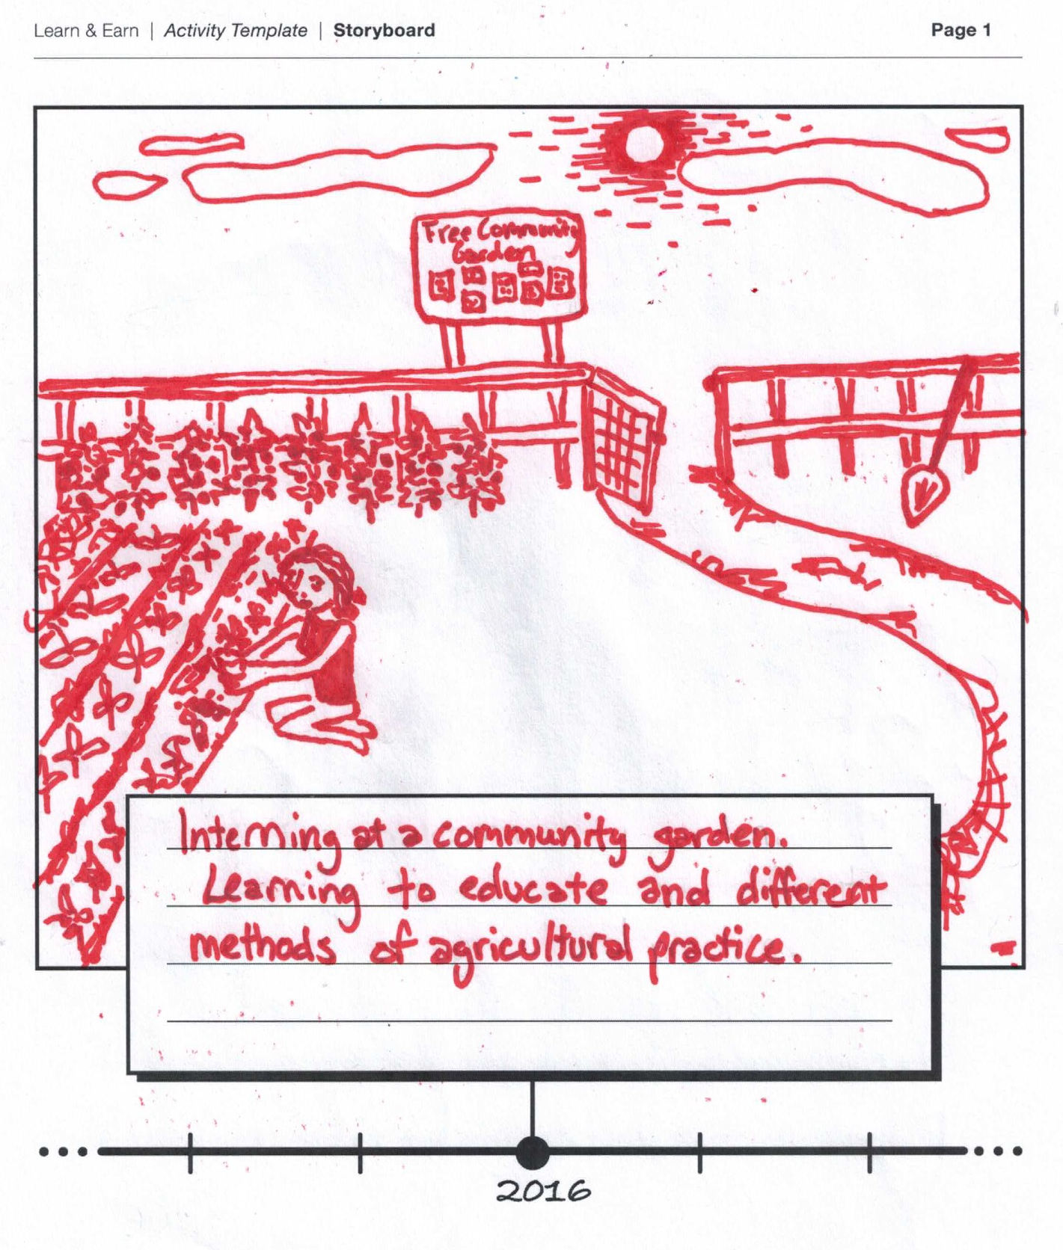
Section III: Envisioning the Future | Example 2016
Example 1:

Slide 62
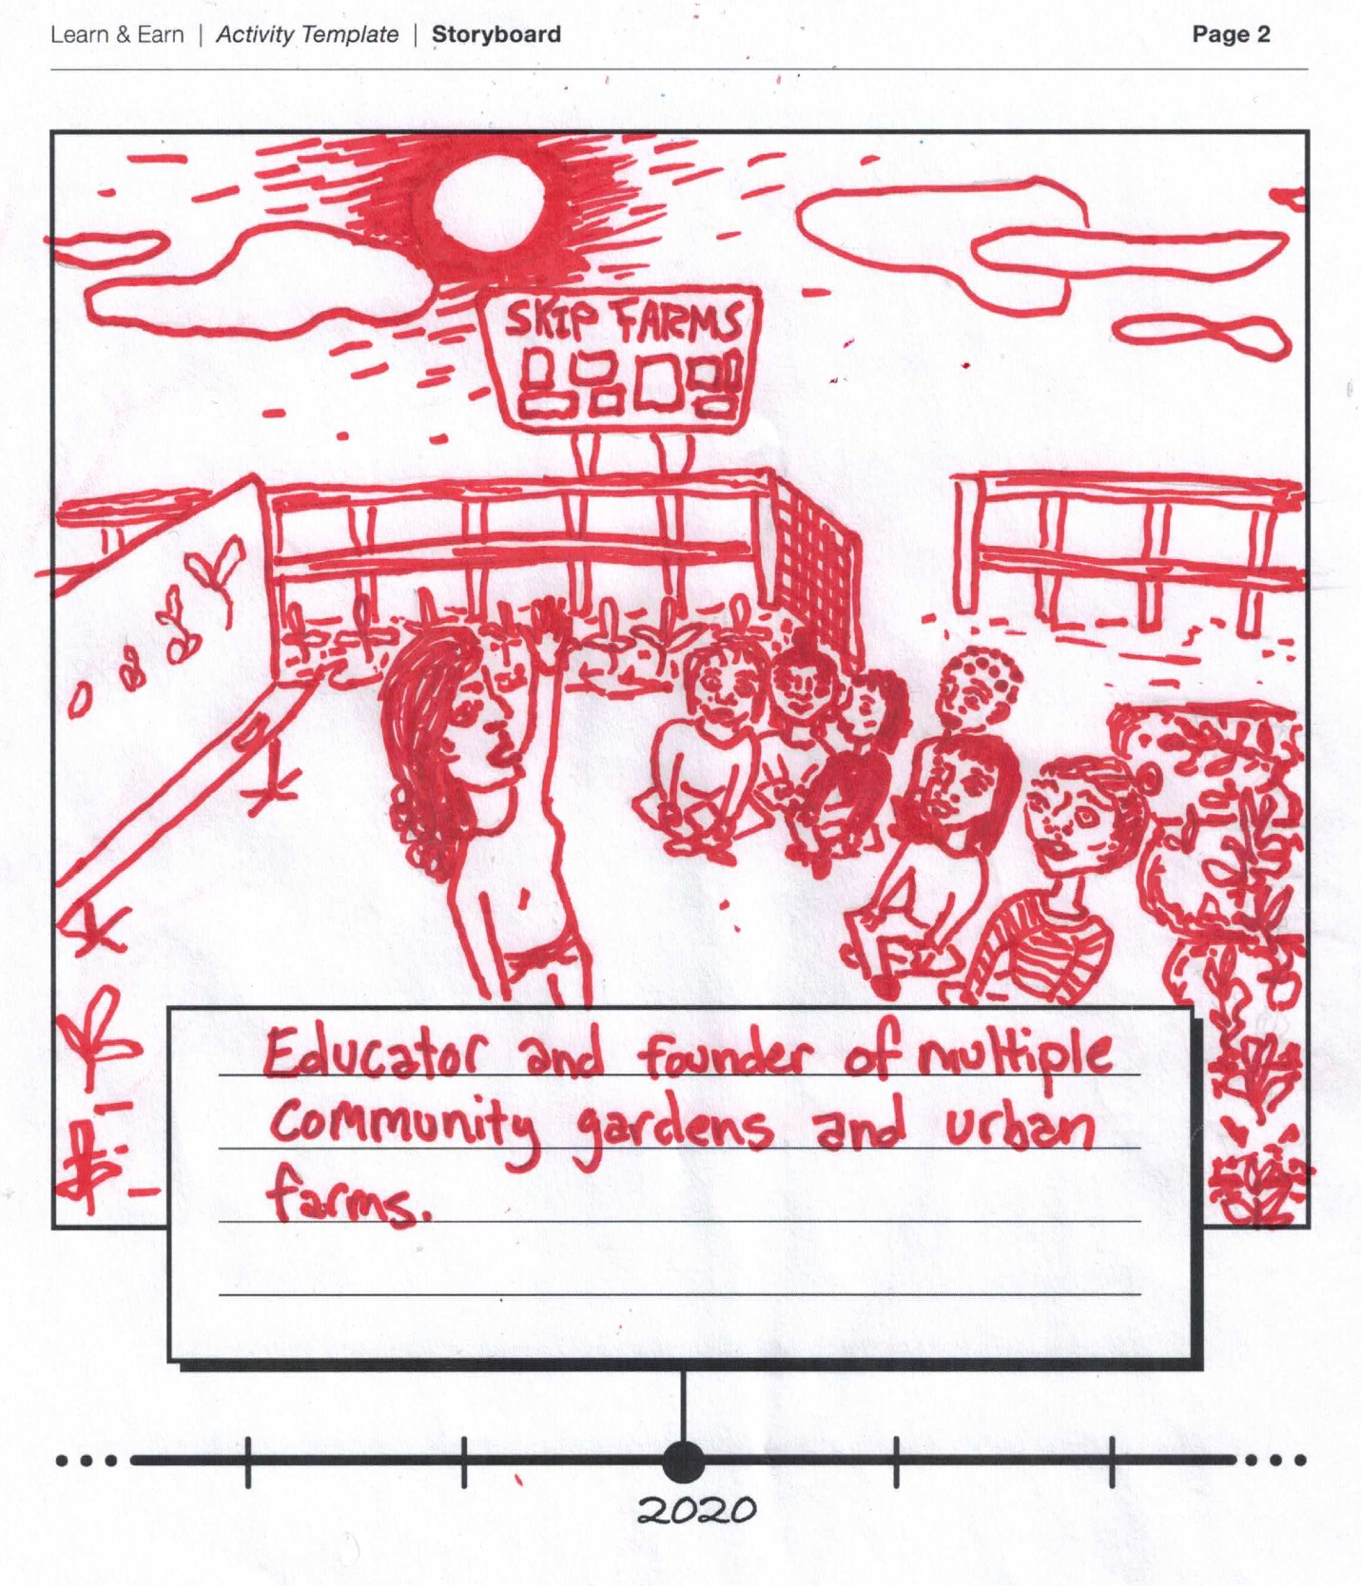
Section III: Envisioning the Future | Example 2020
Example 2:

Slide 63
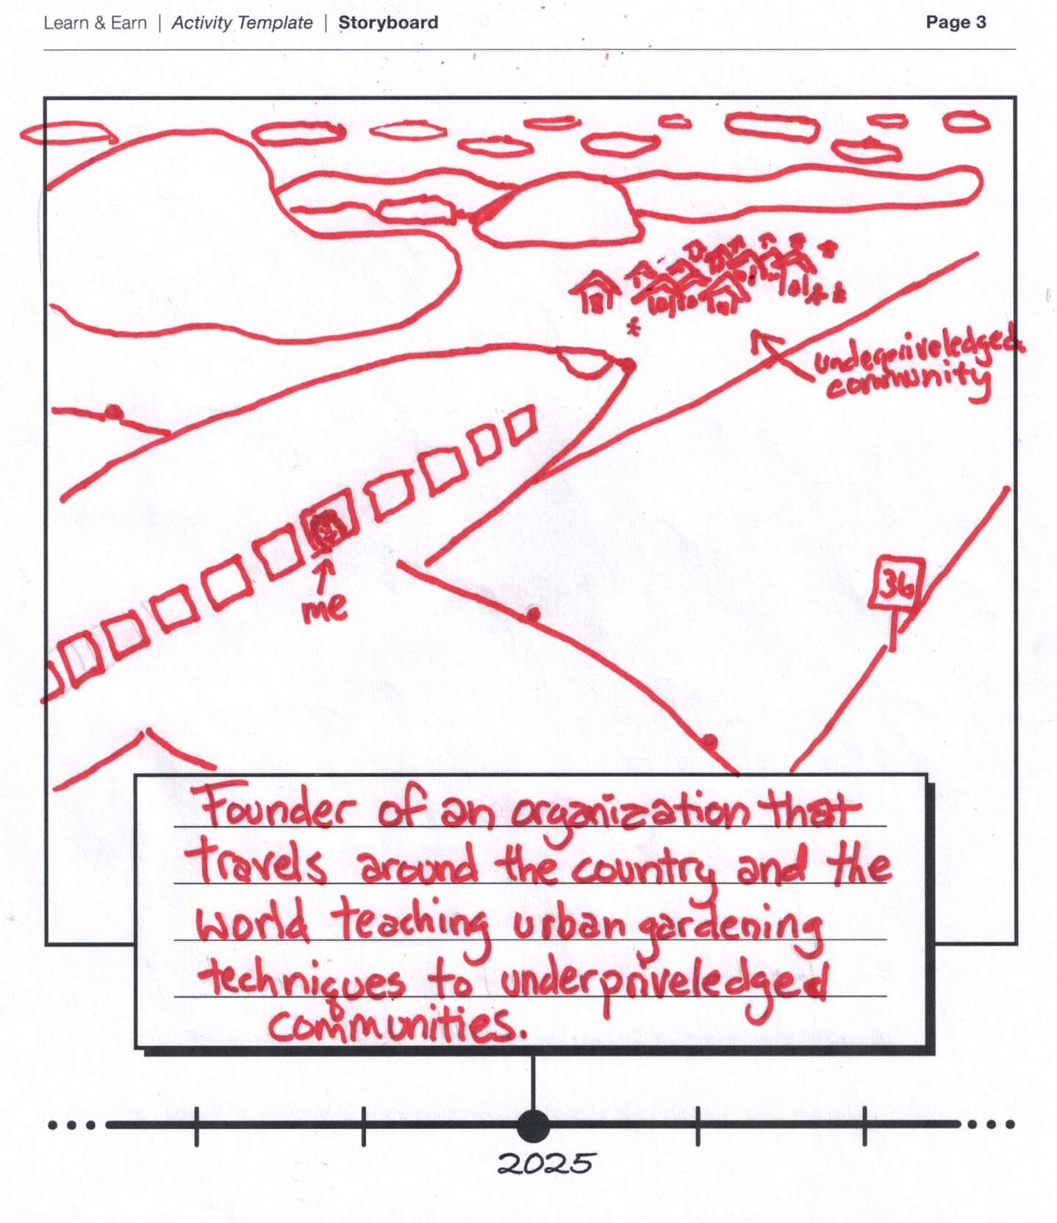
Section III: Envisioning the Future | Example 2025
Example 3:

Slide 64
Section III: Envisioning the Future | Sharing Storyboards
In small groups, share out your respective storyboards and explain the choices you made

Slide 65
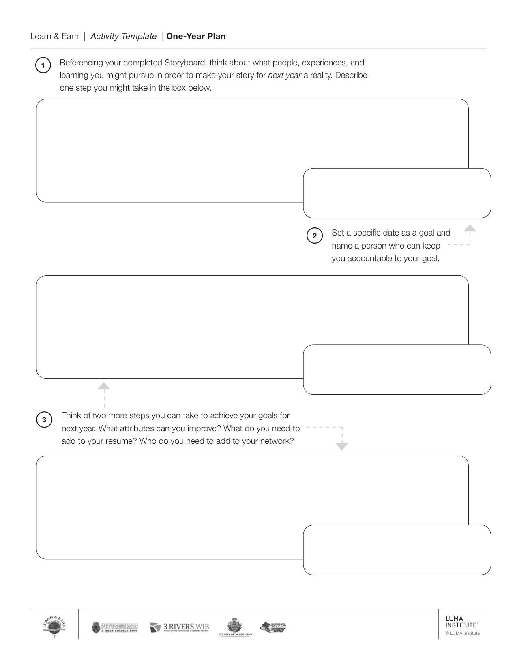
Section III: Envisioning the Future | One-Year Plan
Draw people, places and experiences needed to achieve your desired outcomes; note a specific date and person who can keep you accountable

Slide 66
Section III: Envisioning the Future | One-Year Plan
Note two more steps you can take to achieve your goals; share out the details of your One-Year Plan with your group.

Slide 67
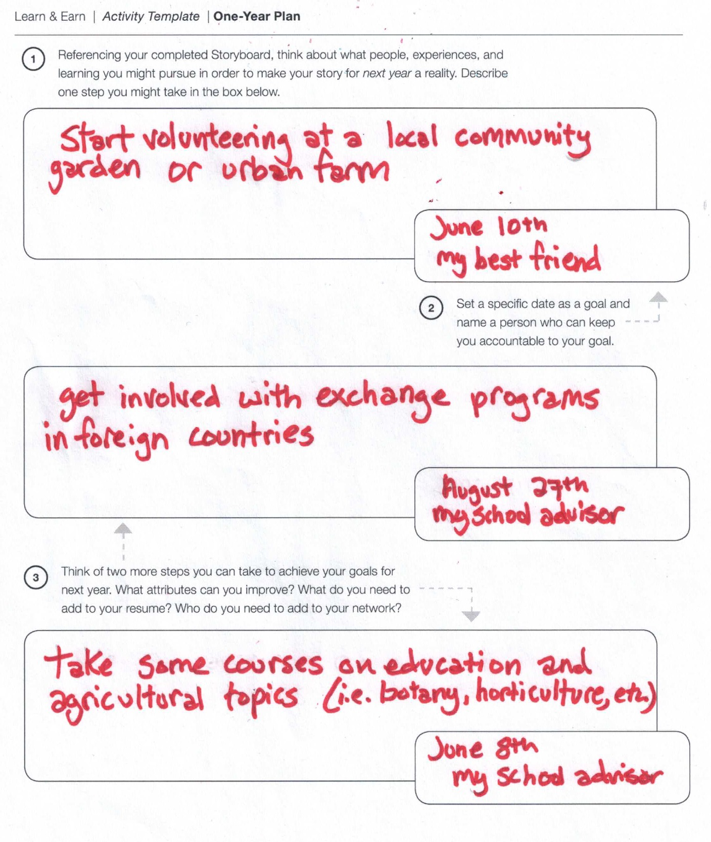
Section III: Envisioning the Future | Example
Example:

Slide 68
Section III: Envisioning the Future | Wrap-Up
What did you observe today?
What are you most excited about in the future?
What scares you the most?
Other than yourself, who will be the primary character in your story?

Slide 69

Congratulations and good luck!

Slide 71
APPENDIX:
Flex Activity Slides

Slide 72
This appendix contains slides for the “Flex Activity” options described in your Facilitator Guide.
There are four activities you have to choose from:
Option 1: Economic Networks (20 Minutes)
Option 2: An Action Plan (20 Minutes)
Option 3: Complete the Résumé (40 Minutes)
Option 4: Outcome of Interviews (40 Minutes)

Slide 73
FLEX ACTIVITY
Option 1: Economic Networks (20 Minutes)
Consider using this activity to help participants deepen and expand their economic networks.
If you decide to use this option:
Move the following three slides into “Section I” of the slide deck (use Facilitator Guide as a reference).
Use “Flex Activity Option 2” (20 Minutes) to complete your 12 hour curriculum

Slide 74
Section I: Mapping Relational Networks | Economic Networks
Put up your Ladders of Production & Marketing templates, and draw lines between similar items. Highlight items that have the most connections.

Slide 75
Section I: Mapping Relational Networks | Economic Networks
Building off of your most-highlighted items, create 2-3 sticky notes of new stakeholders that match these types of work

Slide 76
Section I: Mapping Relational Networks | Economic Networks
Connect these new stakeholders to the relational network you developed in your Network Mapping template

Slide 77
FLEX ACTIVITY
Option 2: An Action Plan (20 Minutes)
Consider using this activity to help participants plan for personal growth.
If you decide to use this option:
Move the following slide into “Section II” of the slide deck (use Facilitator Guide as a reference).
Use “Flex Activity Option 2” (20 Minutes) to complete your 12 hour curriculum

Slide 78
Section II: Attribute Analysis | An Action Plan
Define an action you can take this summer to progress toward each goal you have identified. Identify a friend to keep you accountable.
“I will make my goal come true by doing ________, ________, and ________.
My friend ________ will check in with me in ________ to see if I am meeting my goals.”

Slide 79
FLEX ACTIVITY
Option 3: Complete the Résumé (40 Minutes)
Consider using this activity to go deeper into the résumé process and have participants create an application-ready résumé in a Microsoft Word document. NOTE: This option will require access to a computer lab.
If you decide to use this option:
Move the following six slides into “Section II” of the slide deck (use Facilitator Guide as a reference).
Download the “Resume Template .Doc” file from: http://learnandearnpd.org/resources/activity-templates.html

Slide 80
Section II: Résumé by Design | Complete the Résumé
The Résumé Creation template has several key sections; one section relates to Personal Information
Personal Information
Name, address, contact information
Short profile or biography

Slide 81
Section II: Résumé by Design | Complete the Résumé
Another section relates to relevant work experience
Experience
Position title
Name of employer
Specific work responsibilities and projects
Dates for the period of time employed

Slide 82
Section II: Résumé by Design | Complete the Résumé
A third section relates to relevant educational experience
Education
Name of educational provider or school
Date of educational program
Subject or expertise learned
Qualifications (grades, certificates, degrees, etc.)

Slide 83
Section II: Résumé by Design | Complete the Résumé
A fourth section relates to relevant skills
Skills
Specific technical skills
General professional skills
Etc.

Slide 84
Section II: Résumé by Design | Complete the Résumé
When completing your resume, remember:
Consider the reader
Include and describe content in a way that makes sense given the purpose, audience, stakeholders, and context of your résumé

Slide 85
Section II: Résumé by Design | Complete the Résumé
Using the content from your Résumé Designer template, complete the Résumé Creation template

Slide 86
FLEX ACTIVITY
Option 4: Outcome of Interviews (40 minutes)
Consider using this activity to go deeper into the interview process.
If you decide to use this option:
Move the following two slides into “Section II” of the slide deck (use Facilitator Guide as a reference).

Slide 87
Section II: Both Sides of the Interview | Outcome of Interviews
Make a decision in your respective groups
“Interviewer”
Group
“Applicant”
Group
Would you like to hire the candidate?
List 5+ criteria for your decision
Do you want to work for the Interviewer in the position for which you applied?
List 5+ criteria for your decision

Slide 88

Section II: Both Sides of the Interview | Outcome of Interviews
Present your respective decisions and criteria. Applicants: respond to the decision by your potential employer.
Final Decision
5+ Supporting Criteria
Final Decision
5+ Supporting Criteria
Respond to decision in ~1 minute
Interviewers
Applicants

